Slide 1
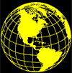
Latitude and Longitude
AGENDA Latitude and Longitude
Essential Questions What is a map? What are the elements of a map? What is a map key and compass rose?
TODAY WE WILL
Complete ‘What is a map’ notes.
Complete ‘Latitude and Longitude’ notes.
Work on ‘Latitude and Longitude’ enrichment activities.

Slide 2
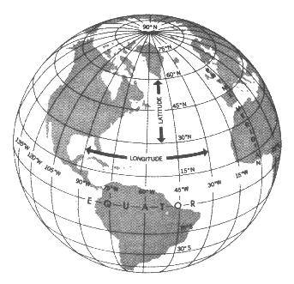
Understanding Latitude and Longitude
Lines of latitude and lines longitude cross one another.
They form a grid system around the earth.
http://www.navfltsm.addr.com/globe.jpg
Notes:
Just like your grid maps that you created of your room at home, lines on globes and maps provide information that can help you easily locate places on the earth too.

Slide 3
Latitude
Lines of latitude are also called parallels.
They circle the earth parallel to the Equator.
They measure north and south of equator in degrees.
The Equator is at 0° latitude.
The North Pole is at
90°N (north).
Maps101.com

Slide 4
Longitude
Lines of longitude are also called meridians.
They circle the earth from Pole to Pole.
They measure east and west of the starting line, at 0° longitude or the Prime Meridian.
Maps101.com

Slide 5
Absolute Location
Only one place can be found at the point where lines cross one another.
Use degrees (°) and minutes (’) to give an exact spot where one line of latitude crosses one line of longitude – an absolute location.
http://www.navfltsm.addr.com/globe.jpg
Notes:
The grid system formed by lines of latitude and longitude makes it easy to find the absolute location of any place in the world.

Slide 6
Hemispheres
The equator circles the middle of the Earth.
It divides the earth into hemispheres or “half-spheres.”
North of the equator is the Northern Hemisphere.
South of the equator is the Southern Hemisphere.

Slide 7
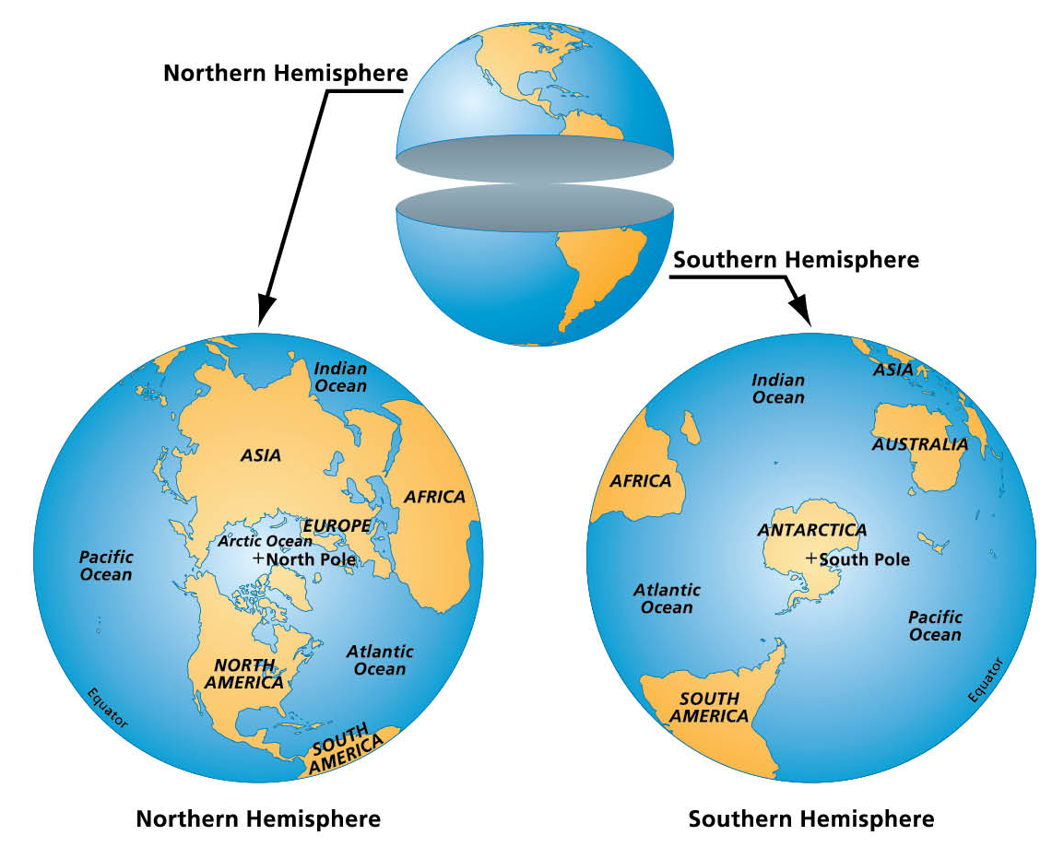
Maps101.com

Slide 8
Hemispheres
The Prime Meridian runs from north to south.
It divides the earth into half spheres in the other direction.
East of the Prime Meridian for 180 degrees is the Eastern Hemisphere.
West of the Prime Meridian for 180 degrees is the Western Hemisphere.

Slide 9
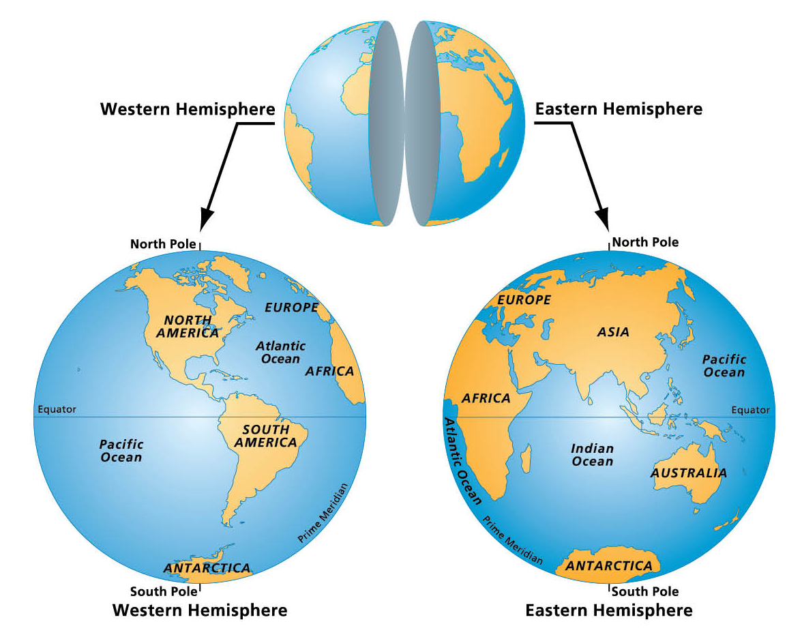
Maps101.com

Slide 10
Tropic of Capricorn
The Tropic of Capricorn (or the Southern Tropic) is the circle of latitude that contains the sub solar point on the December (or southern) solstice. It is thus the southernmost latitude where the Sun can be directly overhead. Its northern equivalent is the Tropic of Cancer

Slide 11
Tropic of Cancer
The Tropic of Cancer, also referred to as the Northern Tropic, is the most northerly circle of latitude on the Earth at which the Sun may appear directly overhead at its culmination.

Slide 12
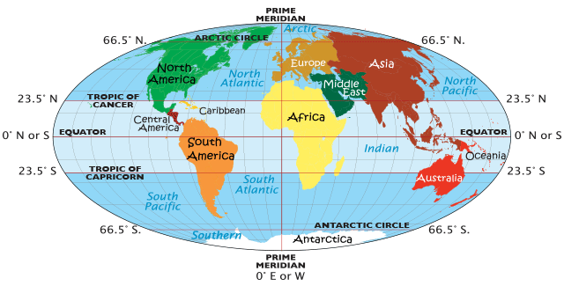
Artic Circles
The Arctic is a region of the planet, north of the Arctic Circle, and includes the Arctic Ocean, Greenland, Baffin Island, other smaller northern islands, and the far northern parts of Europe, Russia (Siberia), Alaska and Canada.

Slide 13
Artic Circle
The Arctic Circle, incidentally, is an imaginary line located at 66º, 30'N latitude, and as a guide defines the southernmost part of the Arctic. The climate within the Circle is very cold and much of the area is always covered with ice.

Slide 14
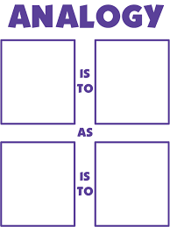
Finish this analogy…
Latitude is to the __________________as Longitude is to___________________.

Slide 15
Finish this Analogy
The equator is to ____________________as the Prime Meridian is to______________.

Slide 16
Acronyms
Create a 4 letter Acronym to remember the 4 Hemispheres.

Slide 17
Finish this sentence…
The Tropic of Capricorn is to the ___________of the Equator.
The Tropic of Cancer is to the _________ of the Equator.

