Slide 1
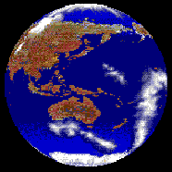
Maps and Globes
AGENDA Maps and Globes
Essential Questions What is a map? What are the elements of a map? What is a map key and a compass rose?
TODAY WE WILL
Define vocabulary words.
Complete graphic organizer while viewing PowerPoint.

Slide 2
Globes and maps
To learn about the Earth, two tools you can use are globes and maps.
A globe is a model of the planet Earth as if seeing it from outer space. A globe is round and shows continents and oceans. There are seven continents on Earth and four oceans.
A map is a model of the Earth shown on a flat surface. Maps are useful because you can carry them with you.
Let’s look at a map more closely…

Slide 3
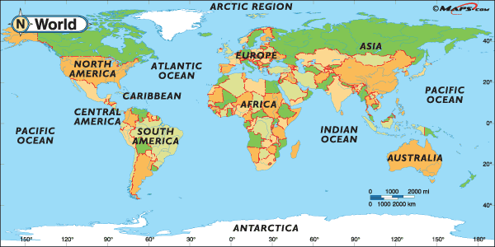
1. Find each of the seven continents on the map: North America, South America, Europe, Asia, Africa, Australia, and Antarctica.
2. Find each of the oceans on the map: Atlantic Ocean, Pacific Ocean, Indian Ocean, and Arctic Ocean.
Find and Label the Caribbean Sea.

Slide 4
Elements on a map
Every map has five important elements:
Title
Legend/Key
Compass Rose
Scale
Inset Map
Each element has a purpose:
The title tells you the purpose of the map.
The legend shows you what symbols on the map mean.
The compass rose is a directional arrow that shows cardinal and sometimes intermediate directions on a map.
The scale is shown in both standard and metric measurements and show distance between objects on the map.
The inset map is a smaller map that shows a “larger” area of land around the map.

Slide 5
Using the Map key
Have you ever seen a star or a dot on a map?
The legend or map key will tell you what those symbols mean.
For example, the map key might tell you that a dot stands for a city.
The key might also indicate that a black line represents a state border.
It might show you how to identify a river with a blue line.

Slide 6
See if you can identify the parts of the map:

Slide 7
Identify the symbols used in the key below:

Slide 8
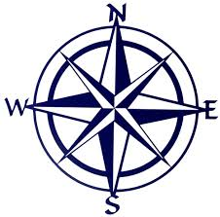
Compass Rose
A compass rose is a design on a map that shows directions. It shows north, south, east, west, northeast, northwest, southeast, and southwest.

Slide 9
Scale
The map scale is used to show the relationship of distance shown on the map to real distance on the Earth.
Notes:
Look at the map, use the scale to estimate the distance from Washington, D.C. to Los Angeles.

Slide 10
Why so many different maps?
Different cartographers (map-makers) use different map projections.
Another reason for this difference is that maps can be created to represent different features of the same places.
Notes:
By now, you've probably seen a lot of maps and noticed that even maps of the same place don't always look the same. Part of the reason for this is that different cartographers (map-makers) use different map projections, but another reason for this difference is that maps can be created to represent different features of the same places.

Slide 11
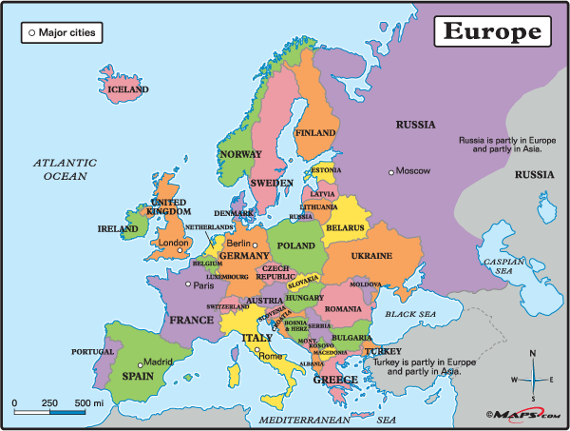
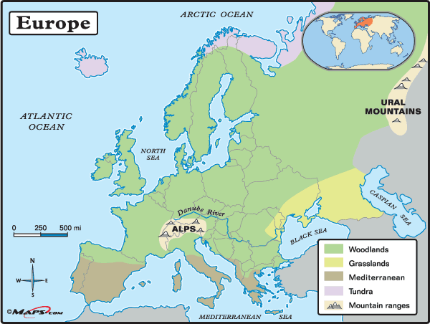
Why so many different maps?
One map of Europe might show only its major cities and state capitals.
Another might depict the country's different vegetation zones.
Another map might show Europe’s physical characteristics.
Notes:
For example, one map of the Europe might show only its major cities and state capitals, while another might depict the country's different vegetation zones. Yet another map might show Europe’s physical characteristics.

Slide 12
What differences do
you see between
these maps?
Do you see any
similarities?

Slide 13
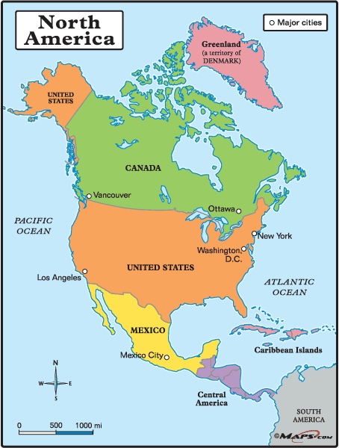
Political Maps
Maps that show countries, states, cities, and capitals are known as political maps.
Notes:
Political maps also show borders or boundaries between countries. These lines are imaginary. If you step from Mexico into the United States, you will not see a line on the ground.

Slide 14
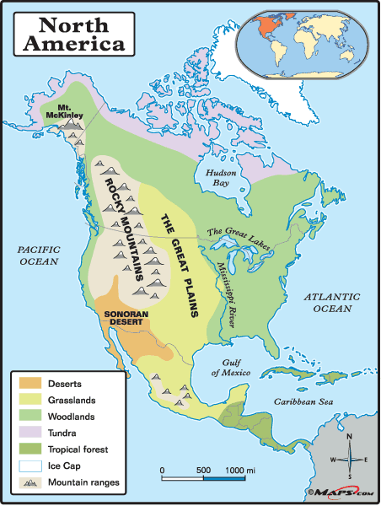
Physical Maps
Physical maps show features of the Earth such as, mountains, rivers, oceans, and forests.
What other physical features are located on the map?
Notes:
Look at the map on the left, how it is different from a political map?

Slide 15
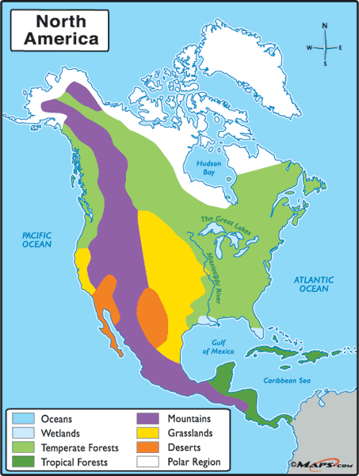
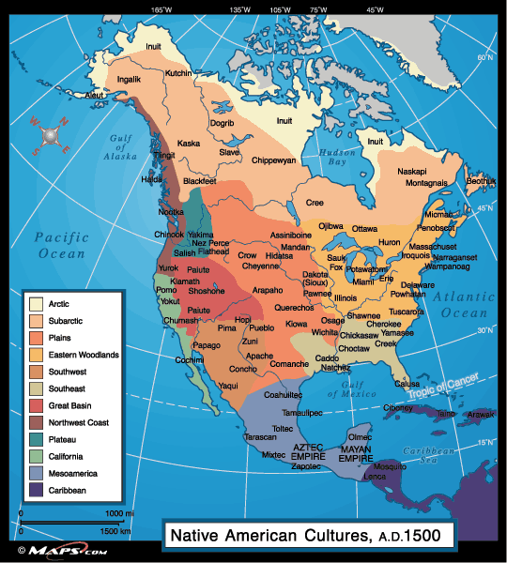
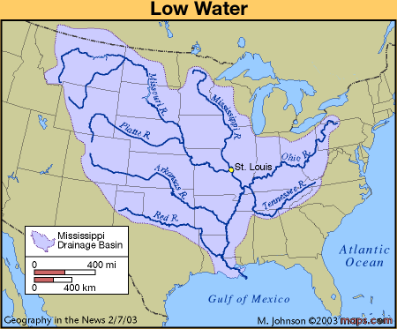
Other types of maps There are many other types of maps
Historical Maps
Road Maps
Climate Maps
Natural Resource Maps
Land Use Maps
Population Density Maps
Etc…

Slide 16
The Coordinate system: Latitude and Longitude
On many maps you see crisscrossing lines with numbers by them. These lines and numbers form a grid system that allows us to describe the absolute, or exact, location of any place on Earth.

Slide 17
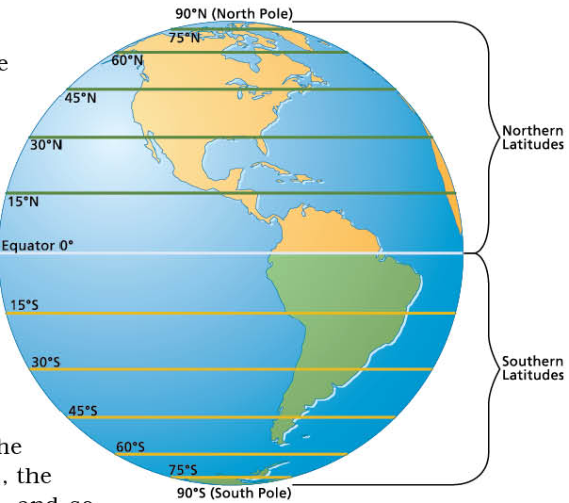
The Coordinate system: Latitude and Longitude
The lines running east to west around the Earth are called lines of latitude. They measure degrees north and south of the equator.
Maps101.com

Slide 18
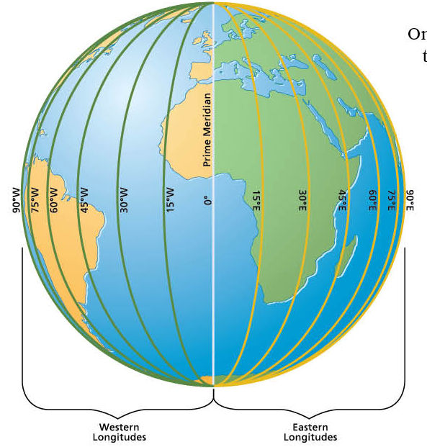
The Coordinate system: Latitude and Longitude
The lines running north to south around the Earth are called lines
of longitude.
They measure degrees east and west of the
Prime Meridian.
Maps101.com

Slide 19
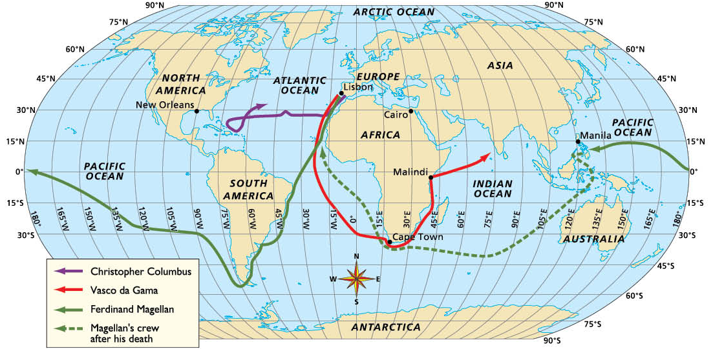
The coordinate system
Together, lines of latitude and longitude form a grid system called the coordinate system.
When you state the coordinates of a place on the Earth you are giving its absolute location.
Maps101.com
Notes:
For example, on the world map below, the coordinates of the city of Cairo (in Africa) are 30◦N, 31◦E.

Slide 20
Compare and Contrast
Compare and Contrast Physical and Political Maps (3 pts. per title). Explain the major comparisons and contrasts, in your own words in 1 paragraph (4 sentences).
Physical Maps
Political Maps

Slide 21
HomeWork
Complete the Graphic organizer

